Slide 1
Eclipse Dataspace Connector – Hackathon tasks

Slide 2
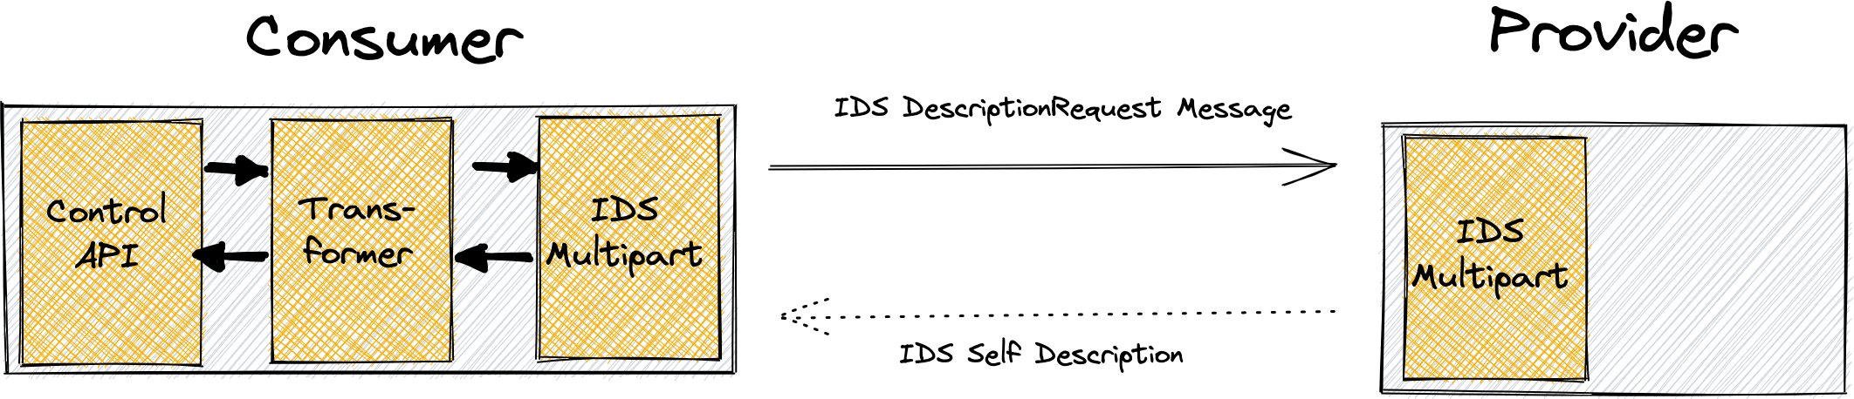
Control API: Retrieve Provider Catalog
Introducing JSON API using JAX-RS for provider catalog retrieval
Leverage the EDC Message Dispatcher to fetch IDS Self Descriptions
Extend transformation subsystem enabling mapping from IDS to EDC domain and vice versa
Verify functional integrity using API Contract Tests

Slide 3
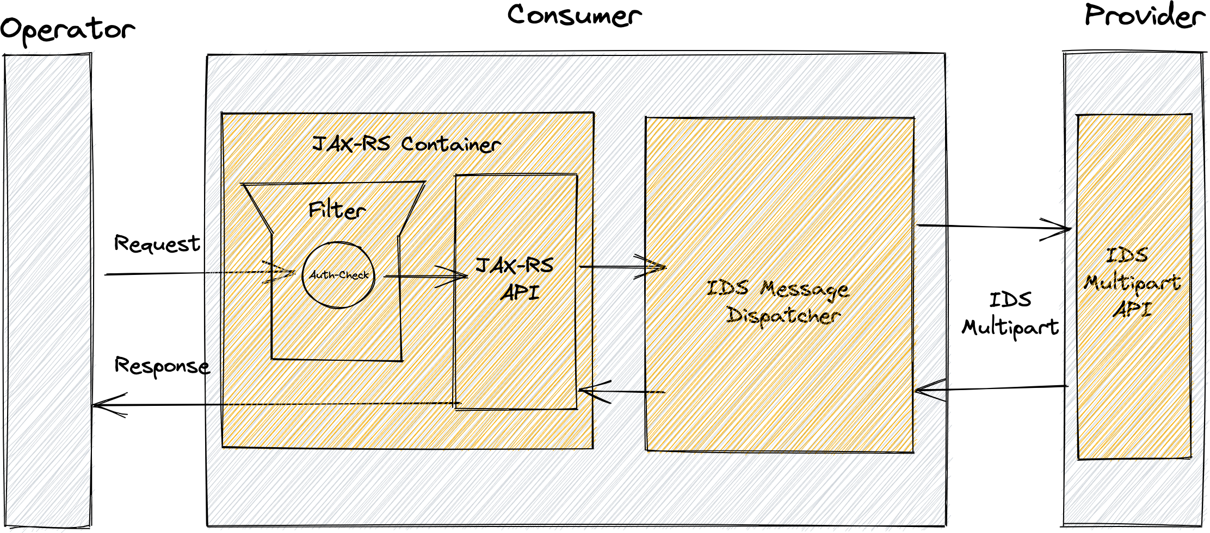
Control API: Authentication Mechanism
Security mechanism preventing unauthorized access of the control API
JAX-RS Container Request Filter verifying presence of API-Keys
Configurable via system environment
Outlook: Extensible library to define custom authentication aspects

Slide 4
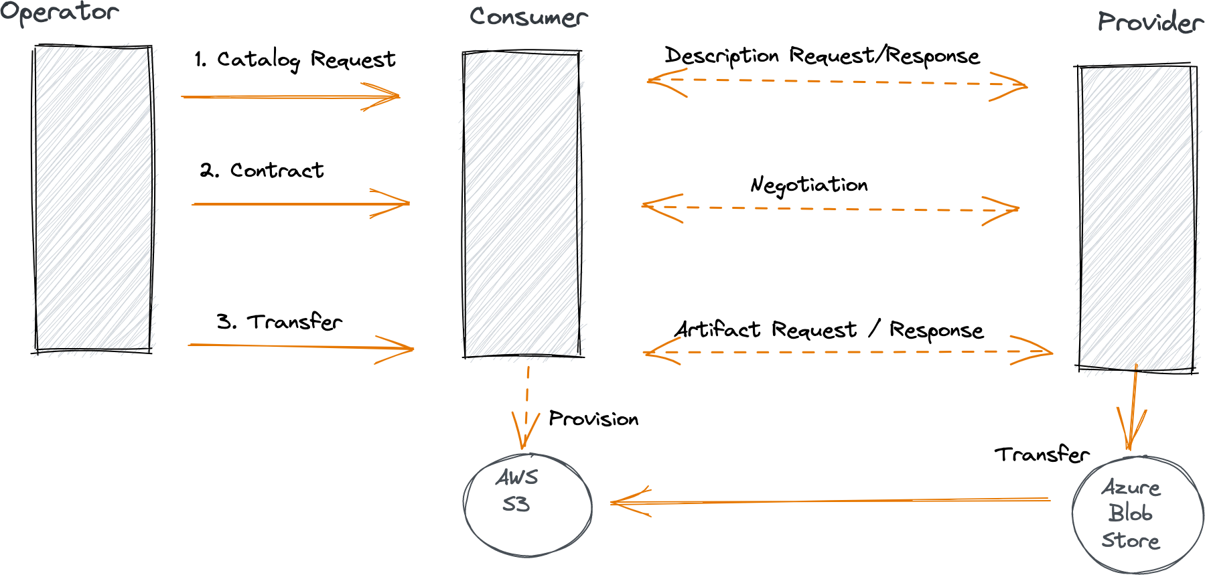
Verify Contract Offer Request Flow
Produce new binaries for the consumer and provider connectors
Update documentation (security mechanism & catalog control API)
Automated infrastructure provisioning using Terraform
Request catalog, negotiate contract and trigger data transfer via control API

Slide 5
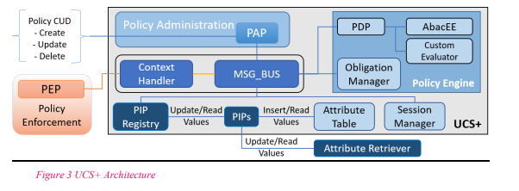
Integrate UCON+ within the EDC
Prepare an extension for policy service called IdsUcsPolicyService
Hook for revoke is in place inside the connectors
Hook can be called by UCS
Connectors listen to UCS obligations and enforce them accordingly
Integrate samples

